Slide 1


ANALYZING BANK CRM DATA
Analyzed By - Thailesh Sinha

Slide 2
AGENDA
  Problem Statement
  Data Description
  Insights

Slide 3

PROBLEM STATEMENT
You are an analytical CRM (Customer Relationship Management) specialist hired by a bank to extract meaningful insights from various customer-related datasets. The bank aims to reduce customer churn, improve service delivery, and enhance customer satisfaction. They have provided you with datasets including customer demographics, transaction details, customer exit information, and active customer profiles.

Slide 4
METHODOLOGY
  We have first analyzed the problem statement and then the data.
  We have used SQL to answer various questions. In SQL we have used different commands like select, group by, order by, joins, window function, right(), update and alter.
  In power BI we have created the Calculated columns, used DAX function to create measures, have applied conditional formatting and slicers to the dashboards.
  We have used Power BI to create various charts and to prepare a dashboard.
  We have also found the discrepancy in IsActiveMember column which we removed by creating a calculated column where we used if function to do so.

Slide 5
DATA DESCRIPTION
  RowNumber: The row number in the dataset, likely used for reference or indexing.
  CustomerId: A unique identifier for each customer.
  CreditScore: A numerical representation of the customer's creditworthiness.
    Credit score:
      Excellent: 800–850
      Very Good: 740–799
      Good: 670–739
      Fair: 580–669
      Poor: 300–579
  GeographyID: A numerical identifier that likely corresponds to a geographical location, such as a country or region.
GenderID: A numerical identifier for the customer's gender, where for example, '1' could represent male and '2' could represent female.

Slide 6
DATA DESCRIPTION
  NumOfProducts: refers to the number of products that a customer has purchased through the bank.
  HasCrCard: denotes whether or not a customer has a credit card. This column is also relevant, since people with a credit card are less likely to leave the bank.
  1 represents credit card holder
  0 represents non credit card holder
  IsActiveMember: active customers are less likely to leave the bank (as per the criteria defined by the bank for identifying the activeness).
  1 represents Active Member
  0 represents Inactive Member
  Estimated Salary: as with balance, people with lower salaries are more likely to leave the bank compared to those with higher salaries.
  Exited: whether or not the customer left the bank.
  0 represents Retain
  1 represents Exit
  Bank DOJ: date when the Customer associated/joined with the bank.

Slide 7
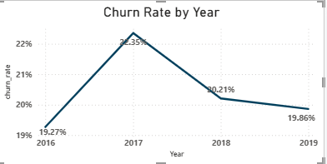
CHURN RATE ANALYSIS
  Churn increased sharply from 2016 to 2017
  Then consistently declined from 2017 to 2019
  2018: 20.21% (significant improvement)
  2019: 19.86% (almost back to 2016 level)
  Suggests successful retention strategies or operational improvements
  2019: 19.86% (almost back to 2016 level)

Slide 8
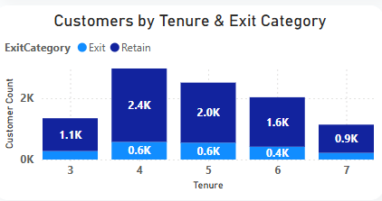
CUSTOMERS TENURE & EXIT CATEGORY
  The highest number of customers are in 4 and 5 years tenure, indicating strong retention during this period.
  Targeted engagement and loyalty programs around 4–5 years tenure could significantly lower exit rates and improve lifetime value.
  Despite high retention, exit counts (~0.6K) are also highest here, making this a critical churn risk window.
  From 6 to 7 years, total customers drop sharply, suggesting long-term retention challenges.

Slide 9
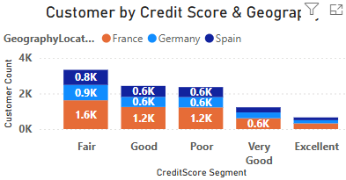
CUSTOMER BY CREDIT SCORE & GEOGRAPHY
  The largest customer concentration is in the “Fair” segment, especially in France, followed by Germany and Spain
  Across Fair, Good, and Poor scores, France consistently contributes the largest share of customers.
  Very Good and Excellent segments have significantly fewer customers, indicating limited presence of high-credit customers.
  The low count in Very Good & Excellent segments highlights a growth opportunity for premium products and low-risk customers.

Slide 10
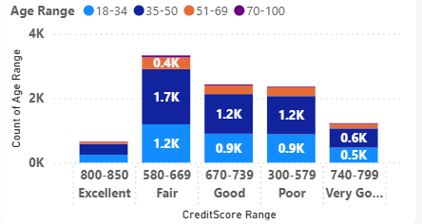
CREDIT SCORE ACROSS AGE
  This segment has the highest customer count, driven mainly by 18–50 age groups, making it the bank’s core customer base.
  18–34 and 35–50 customers consistently contribute the largest share, indicating active earning and borrowing segments.
  Very Good (740–799) and Excellent (800–850) segments show low volume, but represent low-risk, high-value customers.
  Most 300–579 (Poor) credit score customers are below 50, highlighting a need for credit improvement and financial literacy programs.

Slide 11
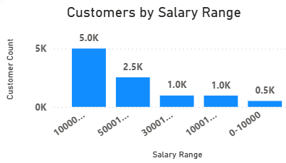
CUSTOMERS SALARY RANGE
  The highest salary range has the largest customer count (~5K), indicating a financially strong core customer base.
  Salaries in the ₹50K+ range (~2.5K customers) show good representation, suitable for loan and investment products.
  Customers earning below ₹30K form a relatively small portion, suggesting lower exposure to high-risk lending.
  Salary distribution can be directly used for credit risk assessment, personalized offers, and churn prediction.

Slide 12
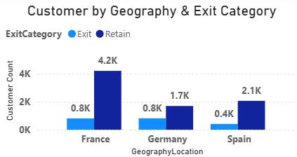
GEOGRAPHY & EXIT RATE
  France shows the highest retained customers (~4.2K), indicating a strong and stable market.
  Although exits (~0.8K) are highest in France, this is mainly because it has the largest customer population.
  Germany’s retained customers (~1.7K) are relatively low compared to exits (~0.8K), signaling a potential churn risk region.
  Spain has the lowest churn count (~0.4K) with decent retention (~2.1K), suggesting better customer loyalty.
  Focus on churn reduction in Germany, retention optimization in France, and loyalty expansion in Spain.

Slide 13

THANK YOU
Data : From Newton School
Applications Used: MS Word, MS Power Point, MySQL, Power BI
sinhathailesh@gmail.com

